Slide 1
Trapped in Hell
By
Ryan Garner 21515288
Lloyd Burton 21516400
Luke Foster 21519352

Slide 2
Game Overview
The game “Trapped in Hell” is a game about a priest hears of a sinful hotel where strange occurrences have been happening, after being sent by the Vatican he has to spend the night at the hotel and investigate these occurrences personally. Unknowingly the hotel was a disguised entrance to hell, armed only with a spray bottle he found and his holy cross the journey begins.
The game fits the following genres RPG, Adventure, Exploration, Action, Roguelike
The game will look different on each floor based around the lore of the demon that is the boss of the floor. For example one floor in the game has a sand/ locust theme based on the demon Abaddon.

Slide 3
Rationale & Scope of prototype build
Based on the time we have for the project we have decided to focus mainly on completing the floor with Abaddon based as its boss. On this floor we intend to have a total of ten rooms, one of which will contain the boss. This will not be procedurally generated in the prototype build of the game but overall that is the intention of the game to be procedurally generated in order to increase the replay ability of the game. There will be two enemies implemented into this prototype build of the game (locust and Abaddon). Lastly there is only one weapon that will exist in this version of the game which is the spray bottle that the hero uses. Although he will be able to gain effects for the liquids he fires from this spray bottle.

Slide 4
Tools
Trello - This software was used to hold our backlog and sprint backlog information.
Unity – This is the game engine used to develop and assemble the prototype.
Piskel – This is a piece of online software used for create 2D sprite pixel art and animations.
Monodevelop – This is a tool used for implementing code into the unity game engine.
Photoshop – This is another artistic software which we used for creating our scene.

Slide 5
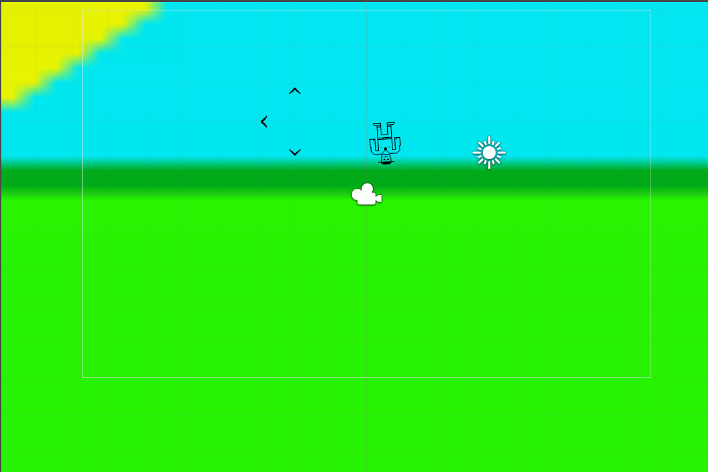
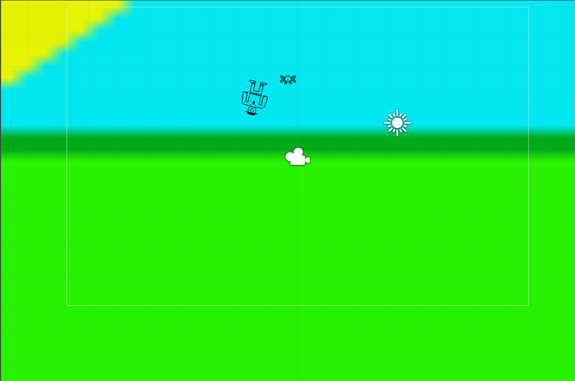
Build 01 - 02
The main features of the builds:
Temporary Character
Movement
Instantiation of projectiles
Reload time
Temporary Enemy
Projectile Velocity
Damage to enemy
New Bugs of builds:
Player rotation – If player collided with an object, the player would rotate.
Multiple projectile instantiated – when multiple inputs are pressed that are all instantiated.
Projectile infinite lifespan – projectiles that have been instantiated have an infinite lifespan.

Slide 6
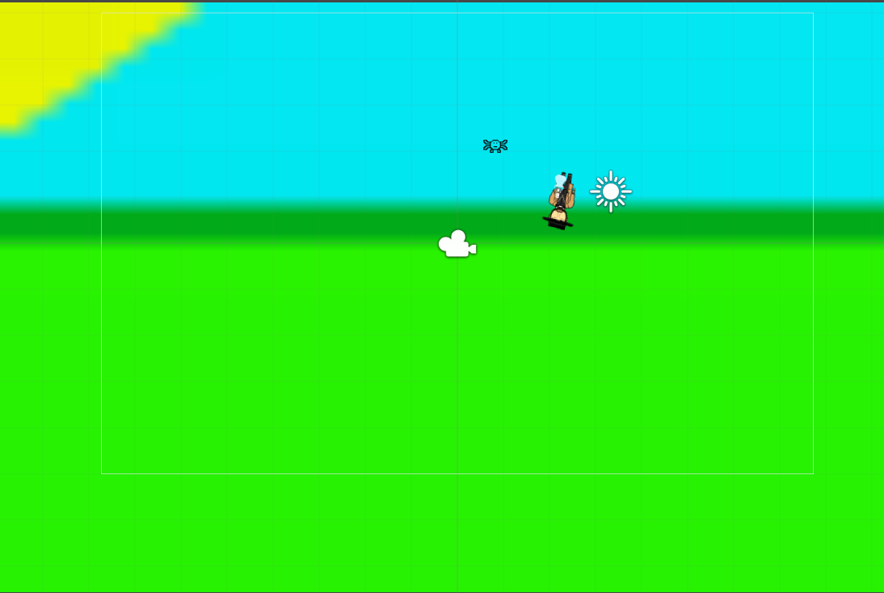
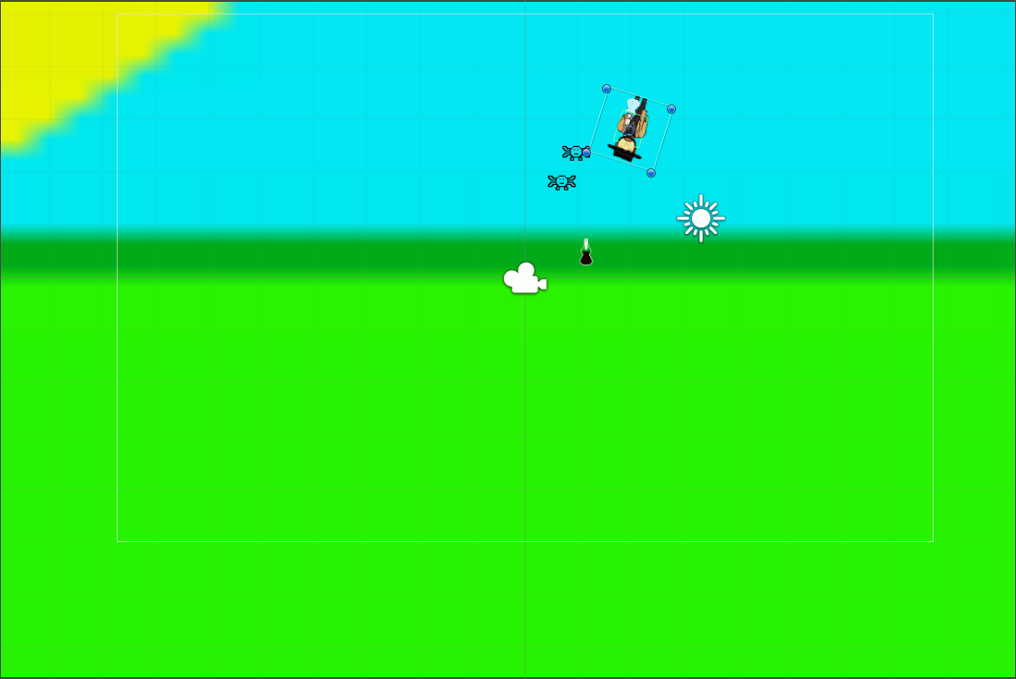
Build 03- 04
The main features of the build:
Implemented character art
Enemy movement
Health
Enemy Damage
Pickup
Ammo Types
Ammo Amount
Multiple versions of the character with the different ammo types
Player death
New Bugs of builds:
Projectile indestructible - Projectile isn’t destroyed on collision with enemy.
Fixed Bugs:
Multiple projectile instantiated – fixed using an else if statement for the firing so that only one could be active at a time, instead of the if statements that were originally used.
Projectile Infinite lifespan – by adding a time constraint to the start protocol of the instantiated object it is set to destroy after that amount of time instead of living forever.
Projectile indestructible – fixed by destroying the projectile on collision with an object after applying the damage to the object if applicable.

Slide 7
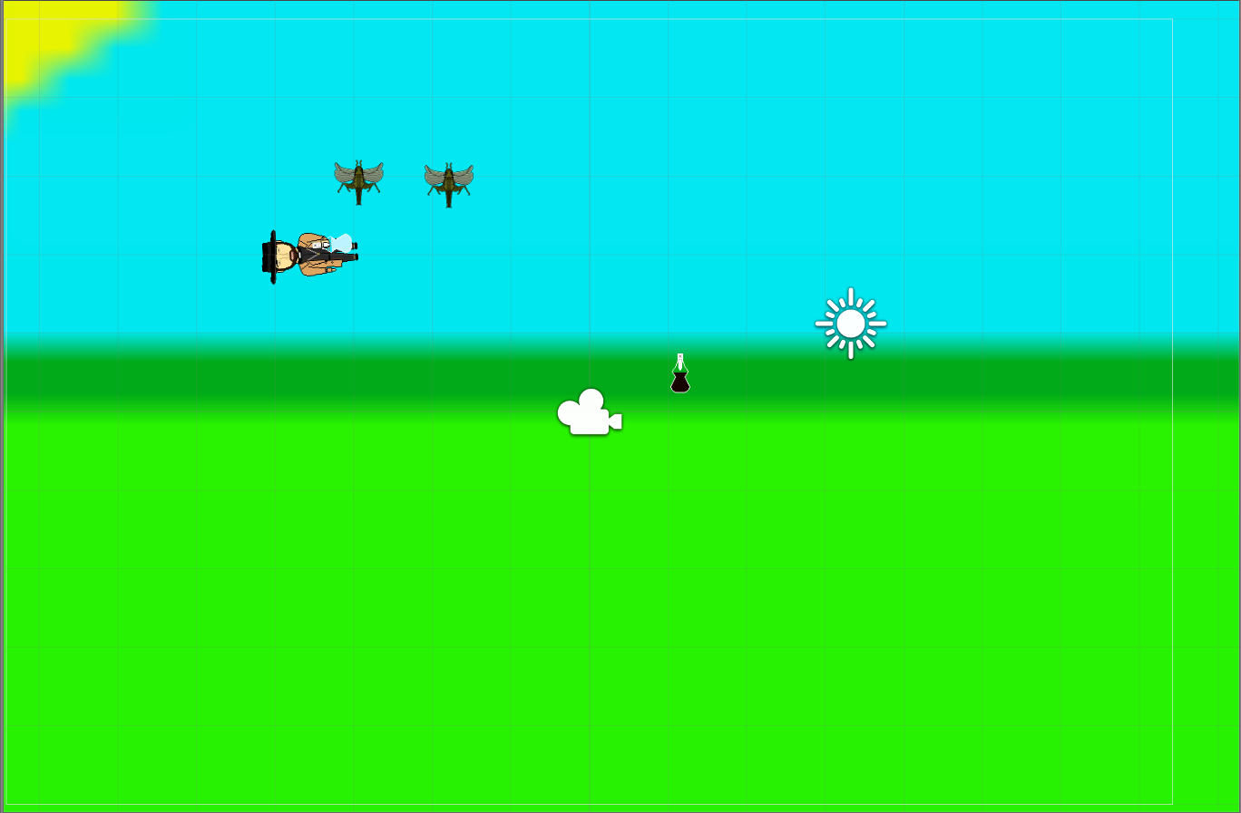
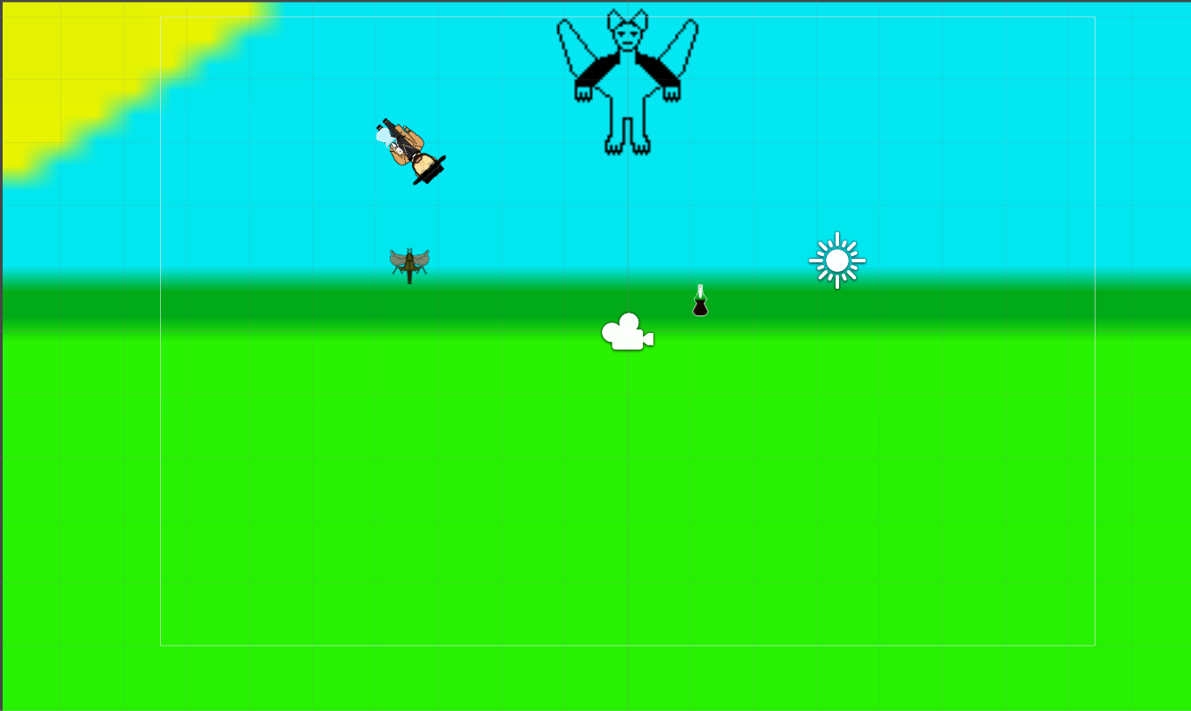
Build 05 - 06
The main features of the builds:
Locust art implemented
Temporary Boss
Boss Projectile
Boss Instantiates Locust
New Bugs of builds:
Fireball created in 3d space instead of 2d space

Slide 8
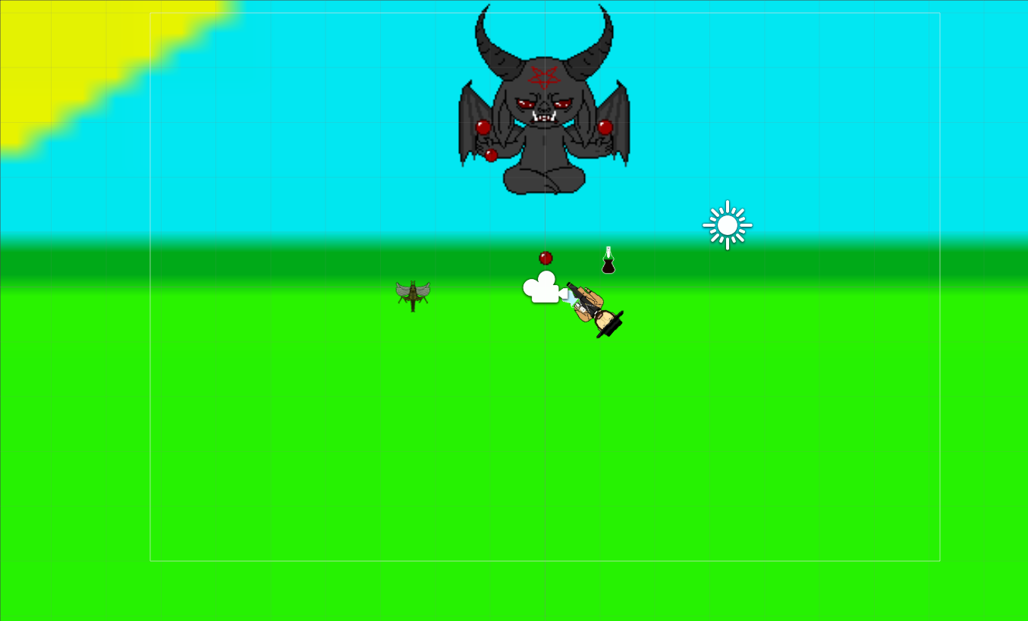
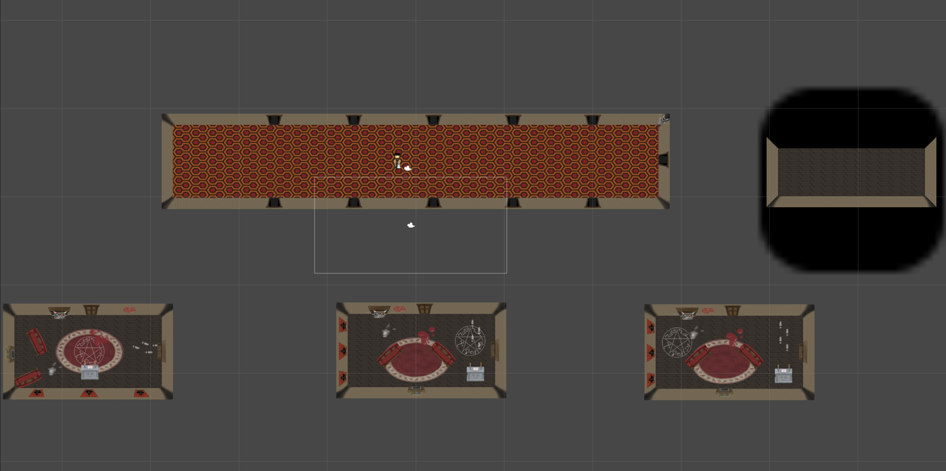
Build 07 – 08
The main features of the builds:
Abaddon artwork
Abaddon attack artwork
Scene Artwork
Door transfers
Fixed Bugs:
Player rotation – to fix on the rigid body we had to constrain to freeze the z axis rotation

Slide 9
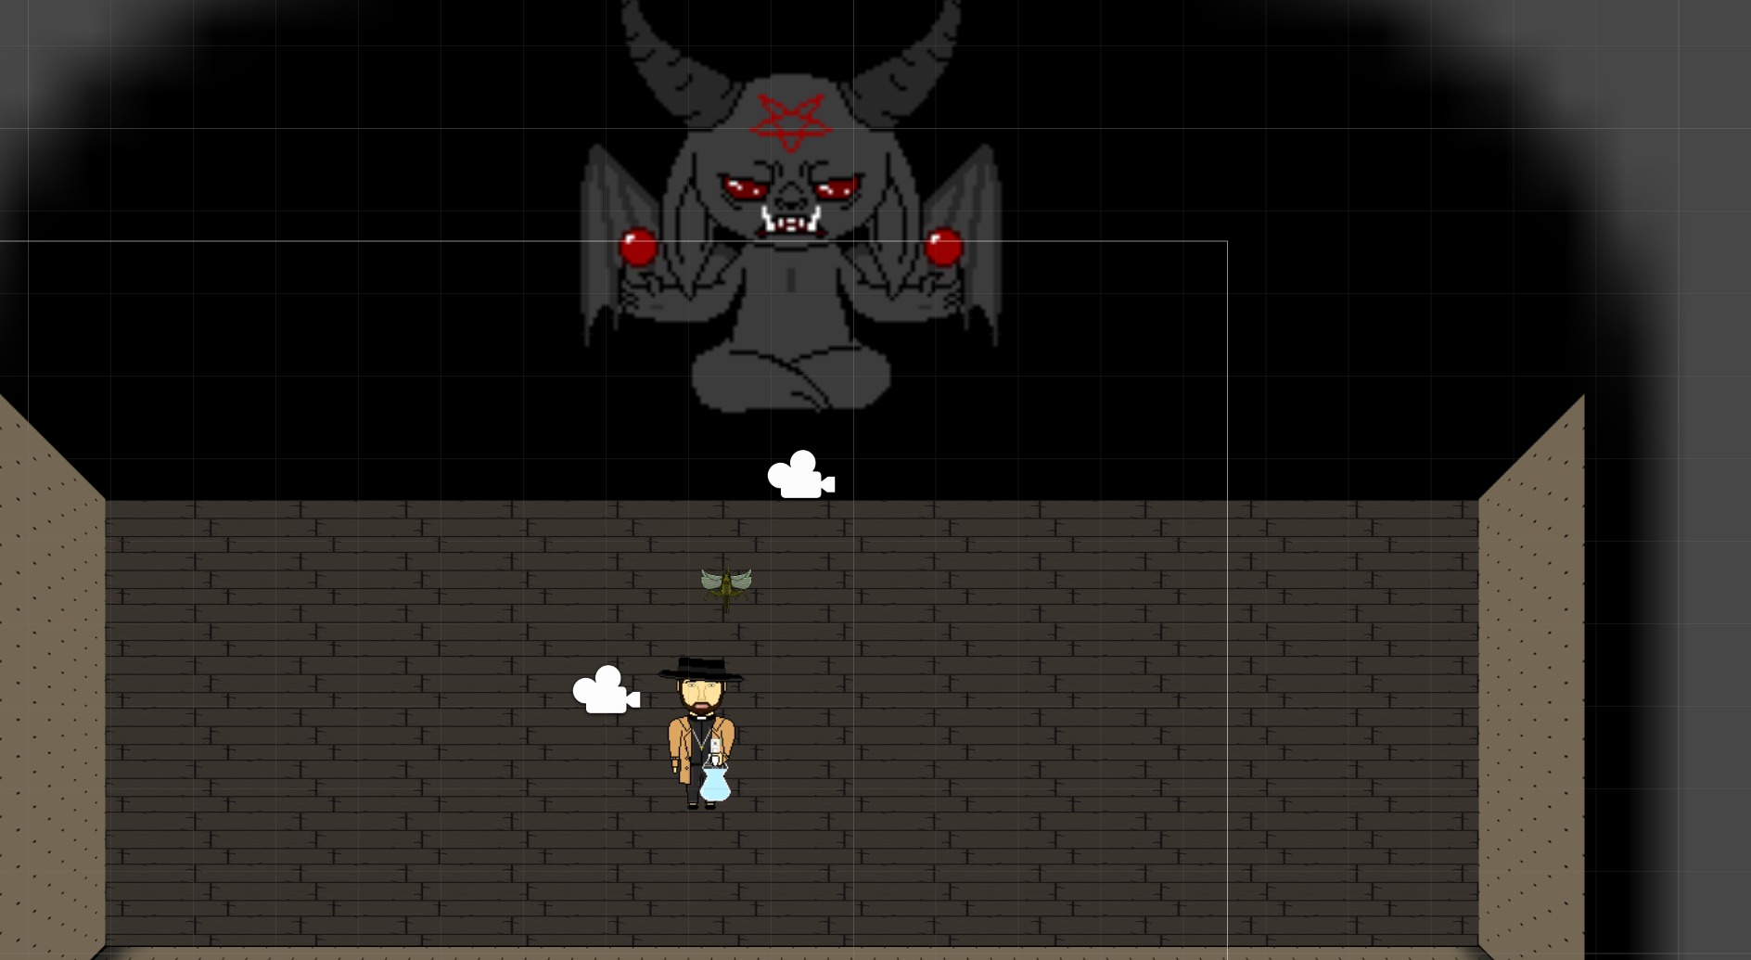
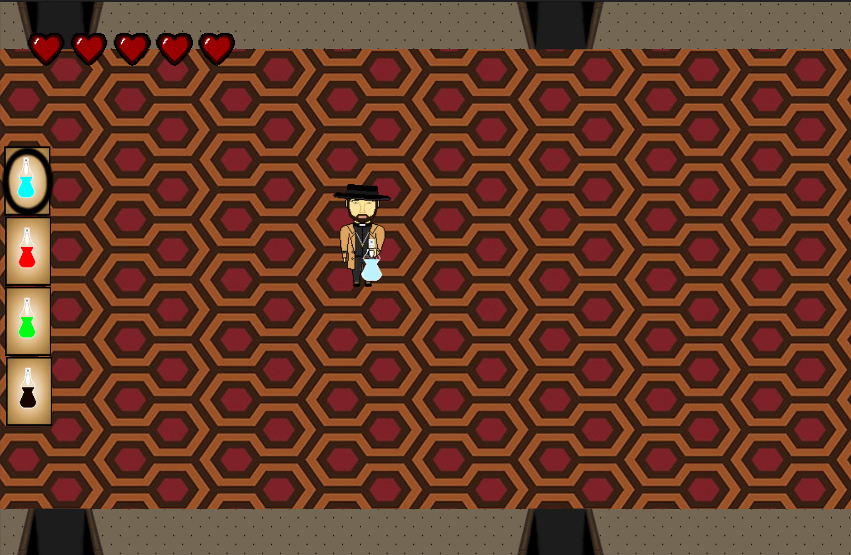
Build 09 - 10
The main features of the builds:
Locusts added to rooms
Boss added to boss room
Health and ammo UI

Slide 10
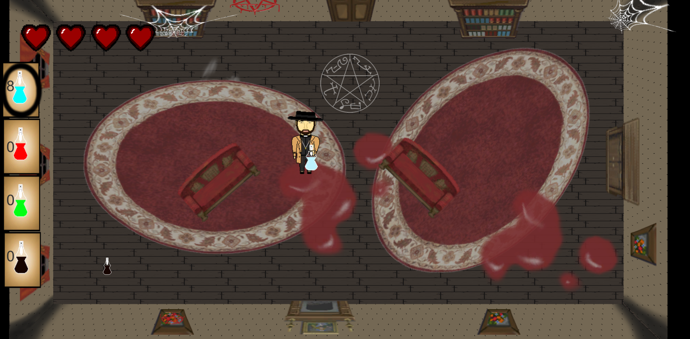
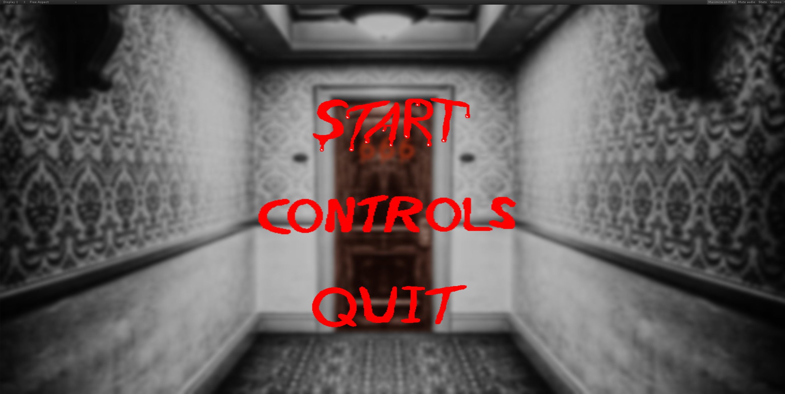
Build 11 - 12
The main features of the builds:
Pickup added to rooms
Boss movement
Quantity of ammo
Menu scene added
Controls scene added
Quit added
Audio for menu screen, as a demonstration of how to implement audio

Slide 11
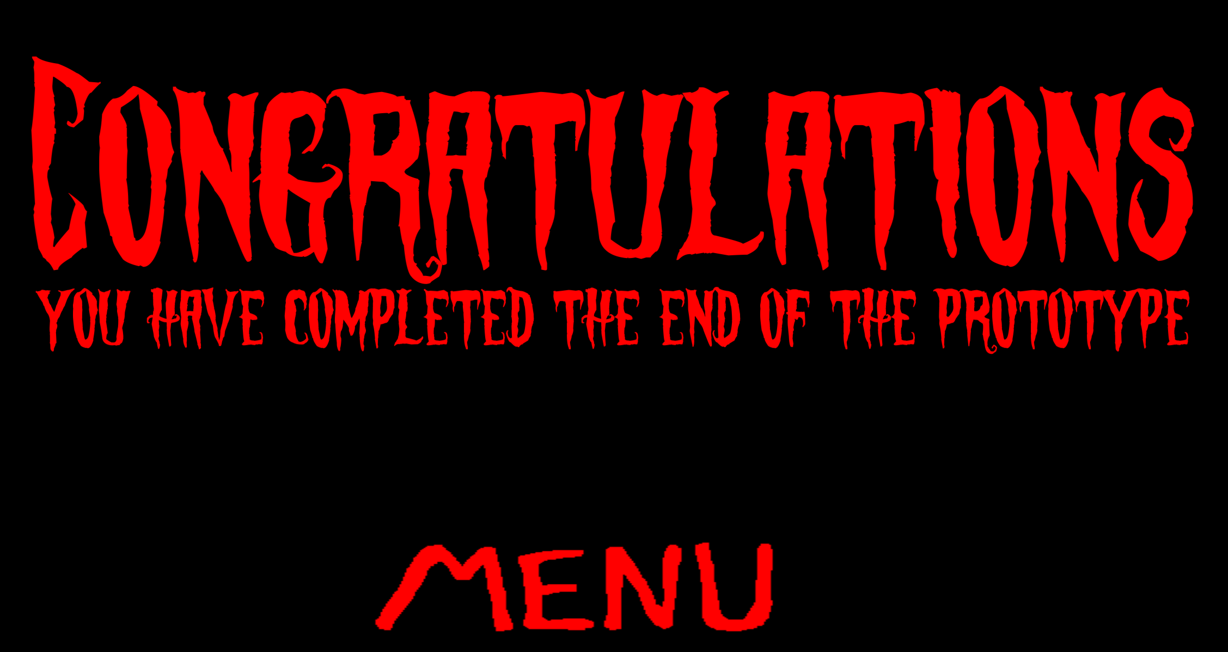
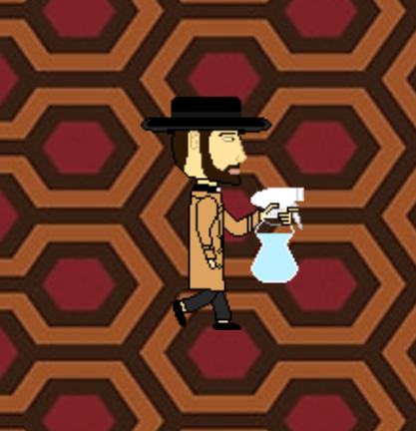
Build 13 - 14
The main features of the builds:
Death scene added
Completion scene added
Character walk animation
Boss room updated
New Bugs of builds:
Character animations don’t face direction of attack

Slide 12
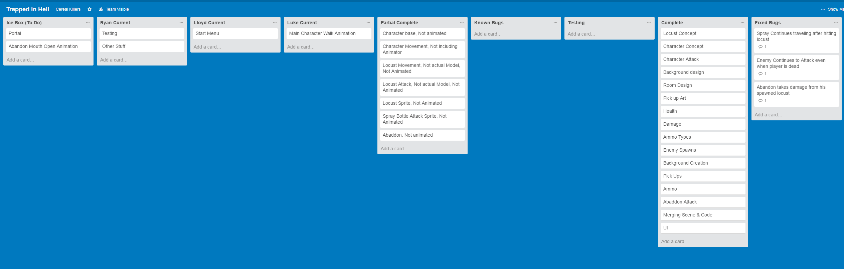
Trello Board
This board is a backlog of all the tasks that were completed throughout the project. Individual tasks were split into three current cards to represent our sprint backlog.

Slide 13
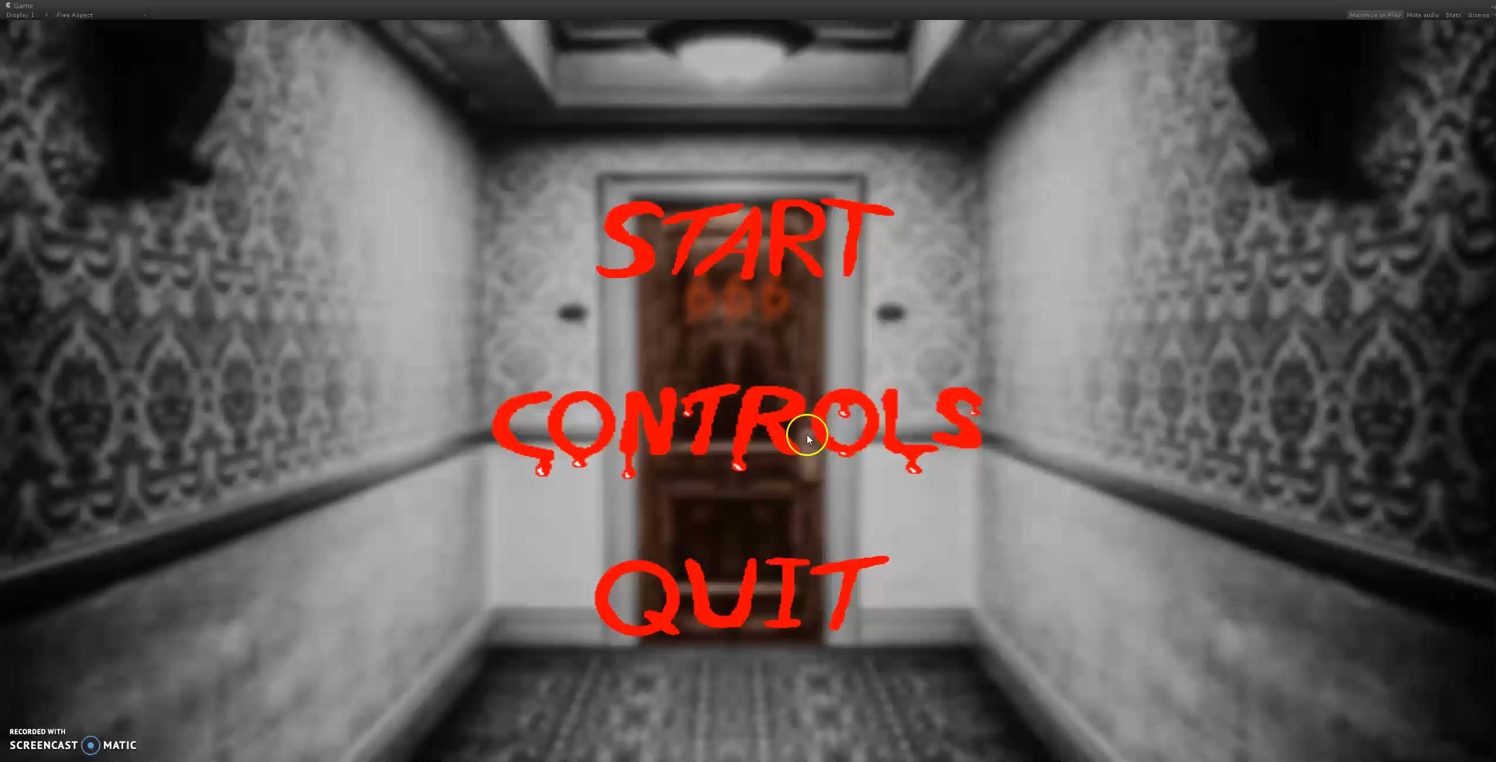
Gameplay Video

